Slide 1
Capstone Retail Analysis
Nishad Purohit
nishad.purohit20@gmail.com

Slide 2
Introduction
The analysis was divided into three sub-categories
Payment module
Time module
Category module
The objective of the analysis was to determine different ways to increase revenue by finding out the below mentioned outcomes.

Slide 3

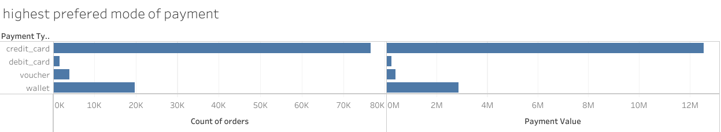
Highest payment type used is credit card
Least used payment type is debit card
Most revenue is generated by credit card
Least revenue is generated by debit card

Slide 4
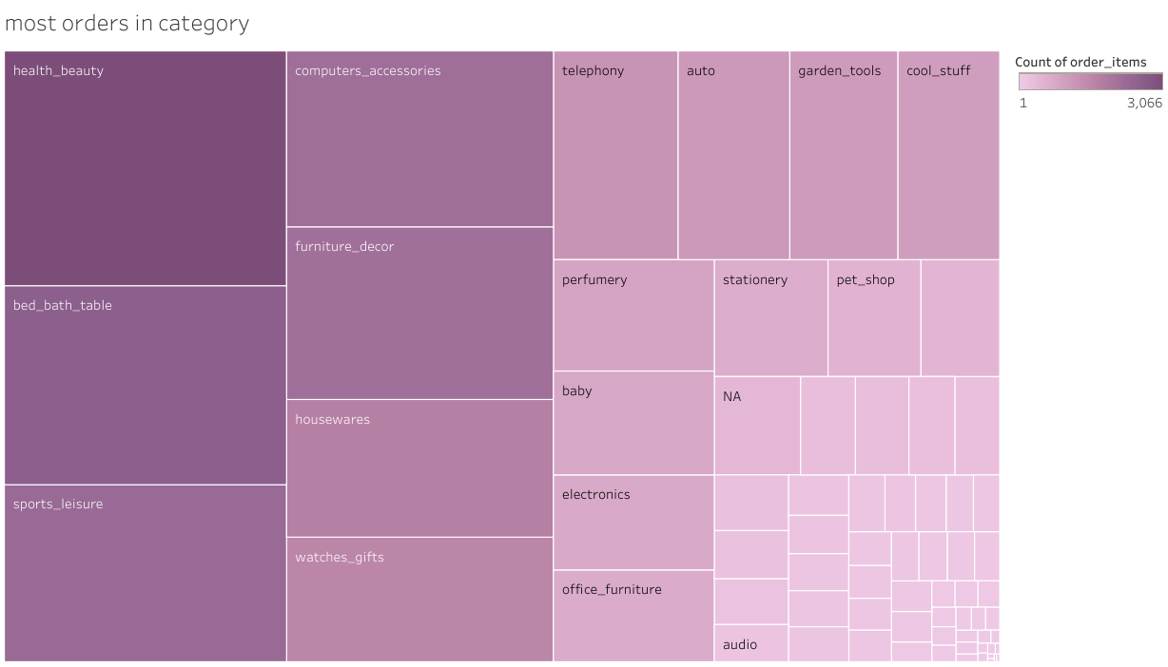
Toys have the most number of orders which is a staggering 84,000
The next is health and beauty
The lowest is security and services with 1 order

Slide 5
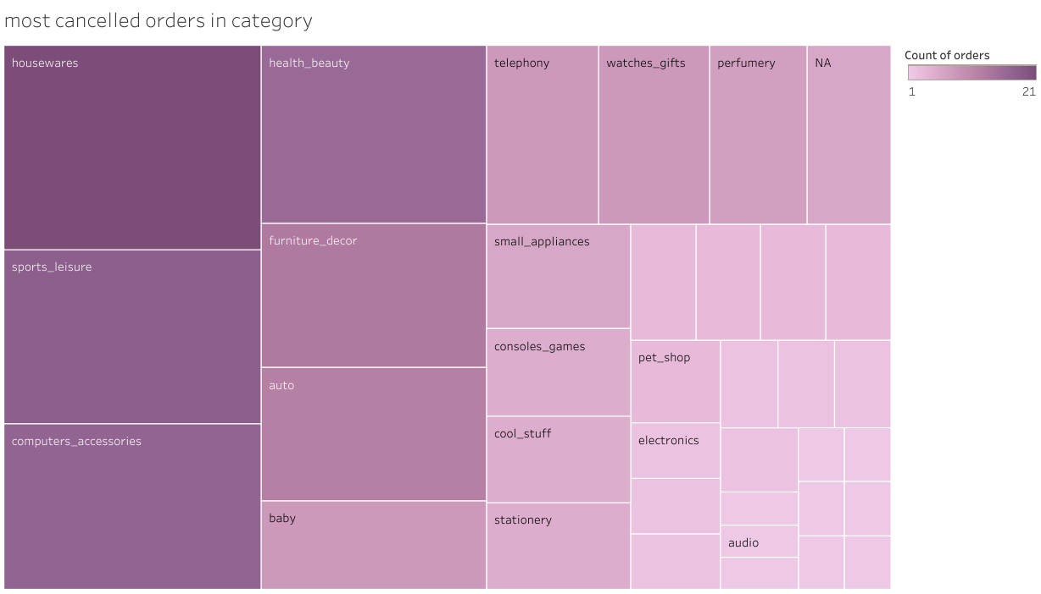
The most cancelled orders are from housewares
Next to it is sports leisure
There are a lot of categories which don’t have a single cancelled or unavailable order.

Slide 6
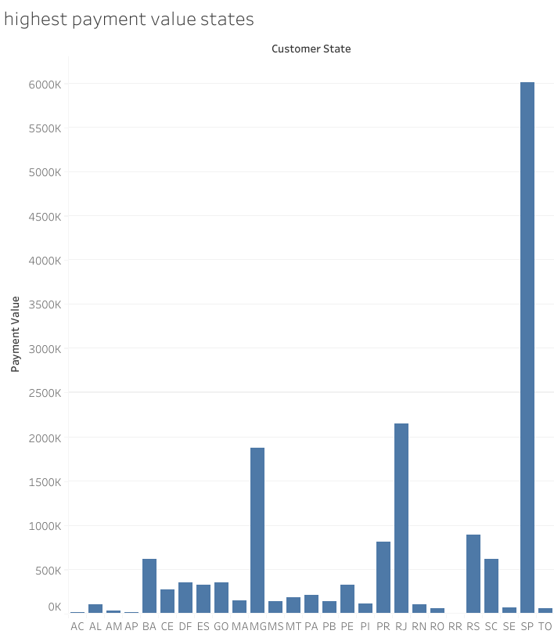
Highest revenue generating states are SP, RJ and MG.
Lowest revenue generating states are AC, AP and RR
States other than those show a common pattern in revenue generation.

Slide 7
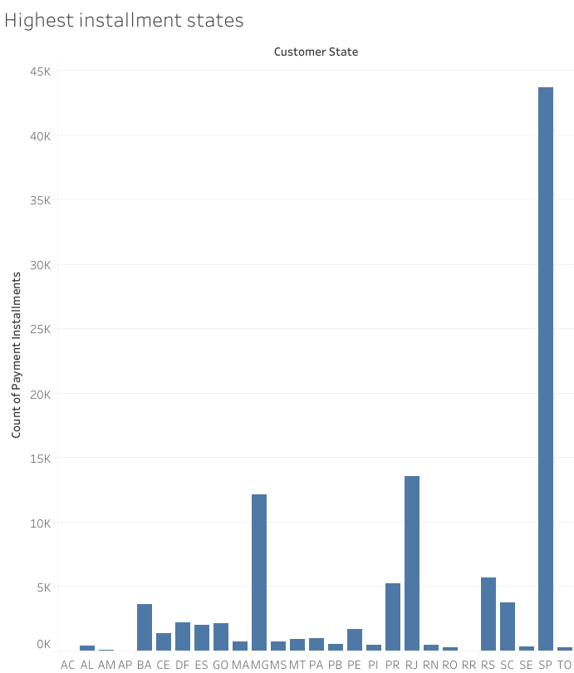
Highest payment by installment seen in the states are SP, RJ and MG.
Lowest payment by installment seen in the states are AC, AP and RR
States other than those show a common pattern in payment installment.

Slide 8
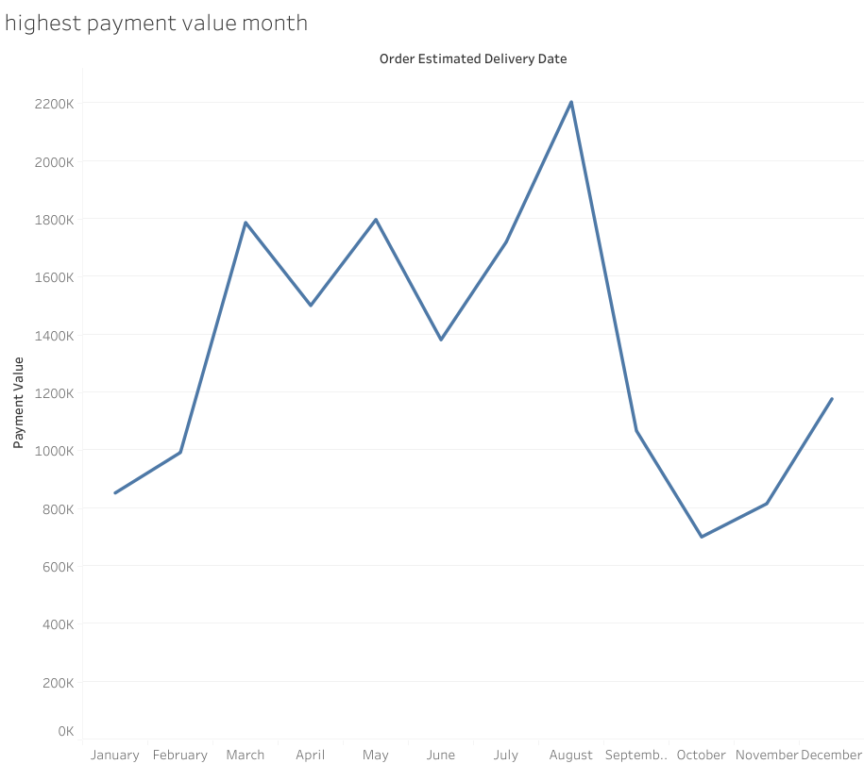
The months with highest payment is August
The months with lowest payment is October
Payment in the months of march and may are nearly the same

Slide 9
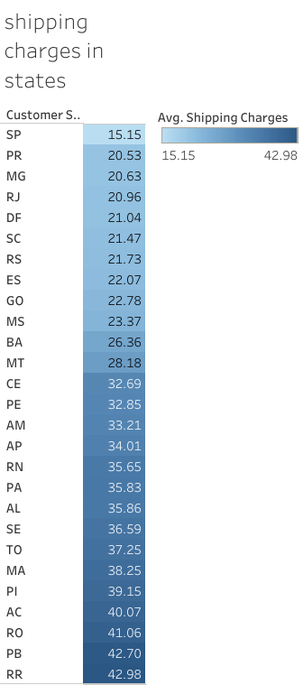
SP has the lowest shipping charges
RR has the highest shipping charges

Slide 10
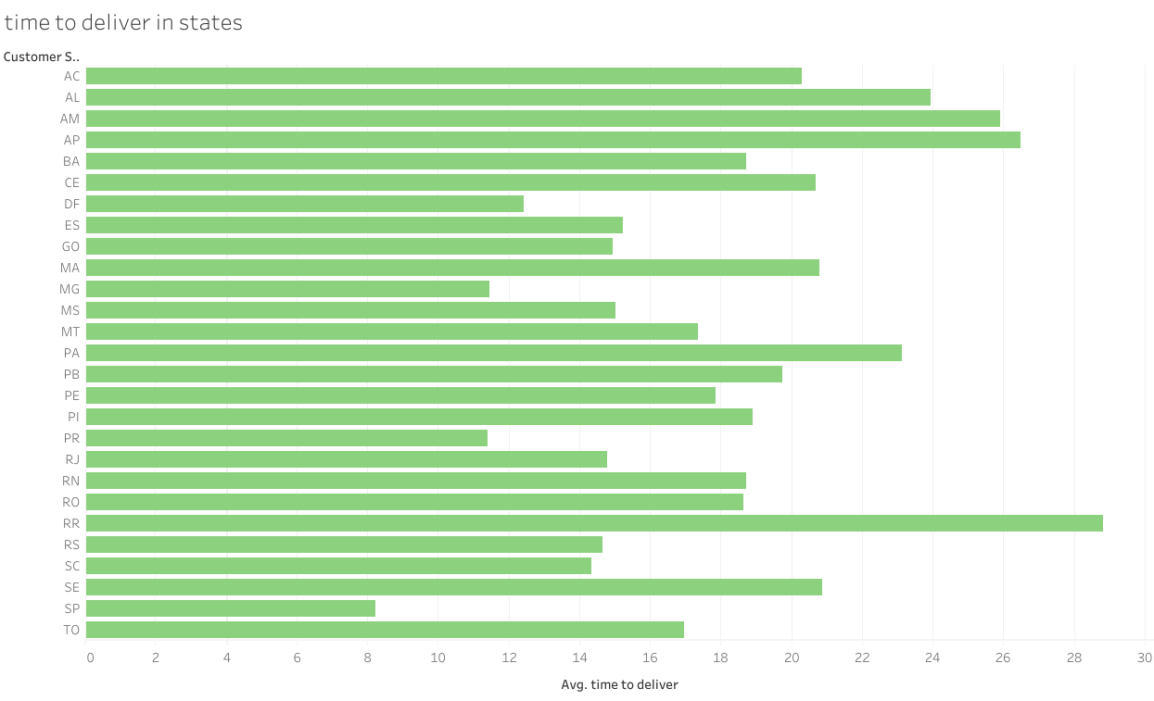
The highest time to deliver is in RR
The lowest time to deliver is in SP
States with higher revenue generation takes less time to deliver

Slide 11
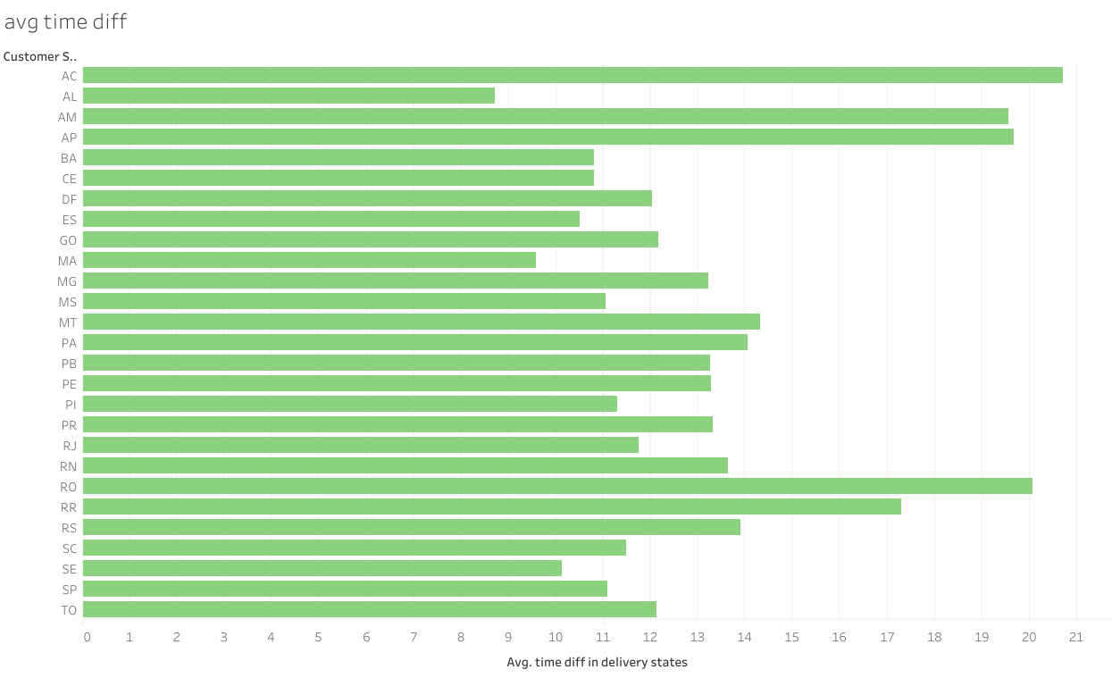
Difference from estimated delivery time to delivery time is less in SP
Difference from estimated delivery time to delivery time is more in AC
States with low revenue generation has more difference in estimated time of delivery to delivery time

Slide 12
Conclusions
The majorly preferred payment type is credit card and the least preferred payment type is debit card. To change the preferred payment type, offers or deals can be introduced.
Categories like health and beauty, sports leisure, computer accessories have both the order rate and cancellation or unavailable rate.
Thus there is no relation or pattern in order cancellation or unavailability.
States like SP, RA, MG, PR, RS, perform well in revenue generation. These same states take less time to Deliver and also has a reliable estimated time of delivery.
These states have the lowest shipping charges as well.
On the other end, States like RR, AP, AC, AM, don’t perform well in revenue generation. These states take more time to Deliver and don’t have a reliable estimated time of delivery.
These states have unreasonably high shipping charges.
Thus to generate more revenue from the states like AP, RR, AC, AM the delivery time and the shipping charges should be decreased.

